Slide 1



Develop & Release
with Confidence
Paul Buote, Strategic Account Executive
Mandy Tong, Sr Customer Success Manager
Parth Patel, Sr Solutions Engineer
Nov, 2023
© SAUCE LABS • CONFIDENTIAL

Slide 2

To create a world of digital confidence.
SAUCE LABS PURPOSE
Notes:
Our mission at Sauce Labs is simple: we want to create a world of digital confidence. We want businesses to have complete confidence that their digital applications will work flawlessly every single time they’re used - and we want their customers to share in that confidence.
The user experience is so critical to business success, and automated visual testing is fundamental to improving the bottom line.

Slide 3
Agenda

Slide 4
1
Sauce Labs Platform Overview
2
Mobile Testing
3
Web Testing
4
Integrations
Reports + Analytics
5
© SAUCE LABS • CONFIDENTIAL

Slide 5
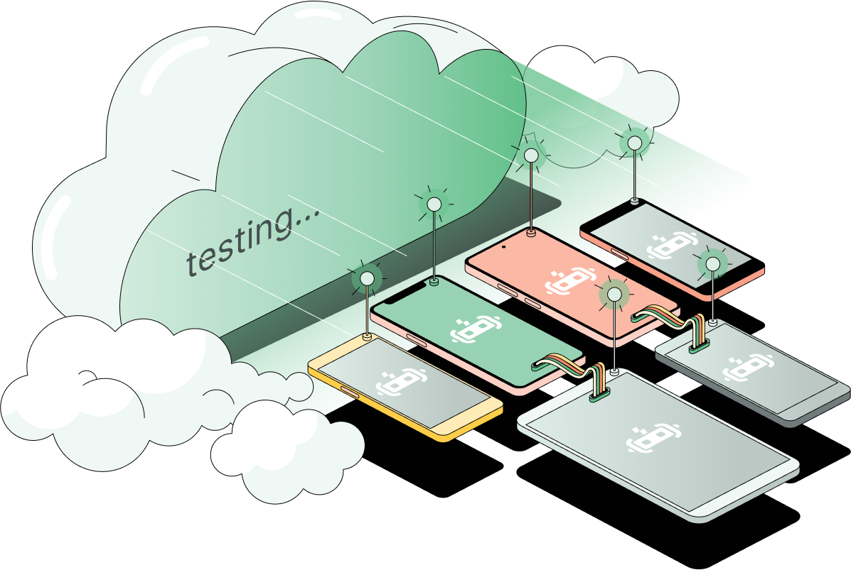
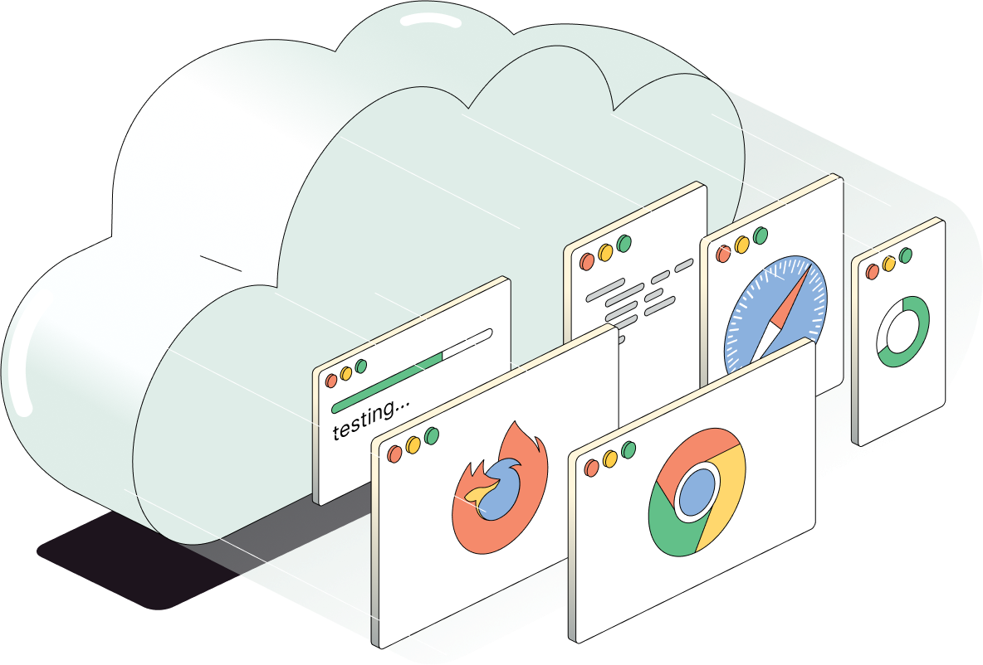









Infrastructure
Infrastructure is the foundation
of continuous test strategy
DEVICE LAKE
BROWSER & OS LAKE
TEST RUNTIME TOOLING
REAL DEVICE CLOUD
PRIVATE DEVICES
EMULATORS & SIMULATORS
VIRTUAL MACHINES
SAUCE CONNECT
SAUCE CTL
REST APIS
VIRTUAL USB
Notes:
Now you may be asking, how do you execute a continuous test strategy?
The answer: a robust test infrastructure that seamlessly integrates with your tools, workflows, and development lifecycle. This level of integration is unattainable with point solutions or disparate test vendors.
Sauce Labs is uniquely able to provide the world’s best test infrastructure to serve as the foundation of your continuous test strategy, including:
A device lake encompassing a real device cloud, private devices, emulators and simulators, as well as virtual machines
Scalability across a diverse browser and operating system landscape
Comprehensive test runtime tooling, including Sauce Orchestrate, Sauce Connect, sauceCTL, along with REST APIs, and Virtual USB
All of which can be flexibly integrated into your SDLC and accessible by teams across your business.

Slide 6
Observability
Platform for Test
UNIFIED DATA & INSIGHTS ACROSS THE SDLC
Applications & Integrations
LIVE TESTING
CROSS-BROWSER TESTING
MOBILE APP TESTING
Infrastructure
DEVICE LAKE
BROWSER & OS LAKE
TEST RUNTIME TOOLING
TEST EXPERTISE & STRATEGY
DEVELOPER TOOLS
WORLD-CLASS SUPPORT
SECURITY & COMPLIANCE
Notes:
Introducing - Sauce Labs Platform for Test
Our platform is the result of more than 15 years of experience in testing, making us the leaders in offering a programmable, accessible, and integratable testing environment. At the core of our platform lies our robust testing infrastructure, supported by our Device Lake, Browser & OS Lake, and Test Runtime and Orchestration toolkit.
But our commitment doesn't stop at test infrastructure. Throughout our extensive industry experience, we've closely listened to our customers and identified areas where they needed more support to ensure software quality. This led to our investment in test ecosystem, including first-party applications and partner integrations. Our ecosystem layer includes streamlined cross-browser and mobile testing, live testing, visual testing, and mobile beta testing. Additionally, our platform supports unified data and observability, providing AI-driven insights across your SDLC.
The Sauce Labs Platform for Test seamlessly integrates these layers, delivering the only consolidated approach to software excellence. Now, let's dive deeper into the value you can derive from each layer of our platform.

Slide 7
Quality @ Speed across the SDLC
Test critical elements of the customer experience
DEV TEAMS
RELEASE
BUILD
TEST
DEBUG
DEPLOY
OPERATE
Reduce build times—get faster feedback on code
Achieve scalable and cost-effective testing
Test with precision for real-world scenarios
Test up to 70% faster, and reduce CI costs
Resolve test failures and errors faster with the broadest suite of diagnostic signals
Get a holistic view of your test results and failure patterns
Streamline Android & iOS app distribution from a single-platform and optimize beta testing
Capture, prioritize, and resolve mobile errors and crashes faster
Emulators/Simulators
Emulators/Simulators
Sauce Orchestrate
Mobile App Diagnostics
Error Monitoring & Reporting
Real Device Cloud
Mobile App Distribution & Beta Testing
Sauce Orchestrate
Insights
FAST FEEDBACK
STABLE BUILD
VERIFY FUNCTIONALITY
READY TO DEPLOY
FEEDBACK
TESTING NEEDS
ACROSS PERSONAS
Developers
SDETS
QA
Prod Owners
Extended Teams

Slide 8
Mobile

Slide 9


Keeping up with the fast-evolving device, OS landscape is unsustainable and costy!
[
Keeping up with the fast-evolving Device/OS landscape is unsustainable & costly!
Popular Device, Browser & Os Releases
New Hardware
ONE PLUS
XIAOMI
HUAWEI
SAMSUNG
GOOGLE PIXEL
APPLE
BROWSER
MOBILE OS
FRAMEWORK
OS
LOG4J
VULNERABILITY
7/2021
8/2021
9/2021
10/2021
11/2021
12/2021
1/2022
2/2022
3/2022
4/2022
5/2022
6/2022
7/2022
8/2022
Software Updates
Includes beta and GA releases for:
FRAMEWORKS - XCUITest, Selenium, Appium, Espresso BROWSERS - Firefox, Safari, Chrome, Edge
MOBILE OS - iOS, Android | OS - Mac, Windows

Slide 10



The TCO for mobile devices on premises is 2x-5x Higher
Hardware Costs
100 Developer/ QA personnel
*10 devices @ $800/device = $ 800K
+ 3x Overhead (in addition to device costs) = $ 3.2M
Soft Benefits Cloud Provides
3x Overhead with Hidden Costs
Procurement and shipping costs
Sourcing devices from multiple manufacturers
Shipping devices to offices and multiple remote locations
Insurance and carrier plan for each device
Maintenance costs
Dedicated person-hours for new OS updates, app version control etc.
Device cleaning after each use
Device replacements; Devices loss, breakage
Operations costs
Dedicated person-hours to manage ongoing support for on-premise devices (lock-outs, crashes etc.)
Security costs
Device security; Legal and compliance fees
 | On Premise Devices | Cloud-based Devices
Scalability
Reliability
High Parallelism
Team Productivity | `
Cost of poor customer experience
Risk to brand reputation, customer churn, revenue loss
Cost of poor developer experience
Resource attrition, lower productivity
© 2022 SAUCE LABS, INC | PRIVATE & CONFIDENTIAL

Slide 11
Mobile Emulators/ Simulators
Real Device Cloud
Mobile App Distribution & Beta Testing
Error Monitoring & Reporting
Scale automated testing cost-effectively, for faster feedback on code early in the development life cycle
Achieve high parallelization by scaling tests across hundreds of the same configurations
Maximize coverage by testing across a variety of virtual OS and platform combinations with the widest range (1700+) of emulators and simulators available on-demand
Get instant access to the most extensive range of Android & iOS real devices
Debug apps faster with the broadest suite of app diagnostic signals
Choose Private and Public devices. Private devices offer you dedicated access, enhanced device management, and customizations
Test Location Services on Real Devices globally using appium.
Debug faster, deploy apps directly from any IDE, and run more complex automation frameworks that require a usb connection (vUSB)
Get highly secure iOS and Android pre-store app distribution in a single platform to ensure only trusted users have access
Leverage user-initiated feedback with intuitive in-app bug reporting interface, and gain real-time insights into the pre-issue events with video recordings
Get enterprise-grade security and compliance (private cloud option, session encryption, and more)
Improve collaboration and feedback time with broad integrations support
Capture, prioritize, & resolve errors, crashes, and exceptions faster
Analyze and share app crashes effectively with dev teams using crash logs
App crashes will provide a stack trace with steps leading up to the crash for fast debugging
INSIGHTS | EXPERTISE | SECURITY
Notes:
Highlight key benefits of each of our Sauce Mobile solutions.
Sauce Labs empowers teams to release high quality software by ensuring apps look, function, and perform exactly as they should in real-world scenarios, on every browser, OS, and device, every single time.

Slide 12

Mobile App Diagnostics
Sauce Labs (Real Device Cloud) offers the broadest suite of app diagnostic information and quality signals to help you accelerate the debugging and release of mobile apps, by enabling faster determination of the root cause of test failures in the pipeline and errors in code.
Included with every Real Device Cloud Subscription!
Capability | Helps you answer.. | Key Benefit
Error & Crash Reporting | “Where in the code is the error happening?” | Automatically collect error and crash data in Real Device Cloud. Get complete context and insights to capture, prioritize, and resolve them faster.
API & Network Capture | “Where is the issue coming from?” | Capture API and HTTP/S requests and responses for mobile app tests. Generate API test scripts by uploading the network HAR file into our API Testing solution.
App Performance | “Why did my app crash?” | Get deeper visibility into app performance with real-time vitals that include CPU usage, memory usage, and UI responsiveness.
Interactions | “What happened in this session?” | Fix UI problems faster with the ability to access user interactions and associating the test session actions with the app's UI.
DevTools for Android and iOS | “Where is the issue on my mobile web app coming from?” | Inspect and debug applications directly on the devices where issues arise, for all your real device cross-browser tests

Slide 13
Web

Slide 14
Virtual Concurrent Sessions
Cross Browser
Testing
Test in Parallel
Debugging
Secure Virtual Machines Access to secure, single use Virtual Machines
Zero maintenance as we support and maintain your test infrastructure in the cloud so you don’t have to
Test on your automation framework of choice
Get instant access to the most extensive range of browsers and browser versions
Broad access to Windows, Mac and Linux virtual machines
Improve quality with massive coverage
Native integration of Google lighthouse for Front End Performance Testing
Increase velocity by testing in parallel
Scale tests across hundreds of configurations
Use the Platform Configurator to seamlessly create new configurations
Capture network calls utilizing the extended debugging feature
Selenium log files and metadata for each test make it easy to share results with dev teams
Analyze failures across your test suites with Failure Analysis
INSIGHTS | EXPERTISE | SECURITY
Notes:
Highlight key benefits of each of our Sauce Mobile solutions.
Sauce Labs empowers teams to release high quality software by ensuring apps look, function, and perform exactly as they should in real-world scenarios, on every browser, OS, and device, every single time.

Slide 15
Integrations

Slide 16













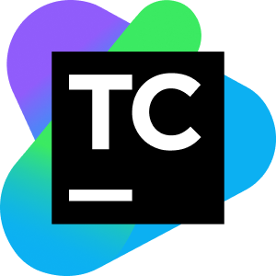








Integrations
SSO
CI/CD
Test Management
Bug Tracking
Accessibility

Slide 17
Reporting

Slide 18
Customize the Insights Scope
Compare Statistical Trends
Measure Coverage
Evaluate a Test Over Time
Analyze Failure Patterns
Troubleshoot
Sauce Labs Insights
Improve your build efficiency and get the most out of your test results
Learn about the different ways in which you can filter and expand the test views to isolate the most relevant data
See how different tests perform on the same platforms or devices to spot pervasive issues
See how many different browser and device variations your tests cover
Look at a test’s result history to pinpoint when failures were introduced and in what configurations
Let Sauce machine learning evaluate your test suite to detect underlying weaknesses in your tests or app
Use our debugging tools to dig into specific test failures and pinpoint root causes

Slide 19
What’s next?

Slide 20
1
Sauce Visual Testing - Q4 2023
2
XCUItest on Sims - Q4 2023
3
iOS Sims (ARM) - Q1 2024
Coming soon!!
© SAUCE LABS • CONFIDENTIAL

Slide 21

Thank you

